Slide 1
Convolutional
Neural Network
2017. 07
Jiyuu Yi

Slide 2
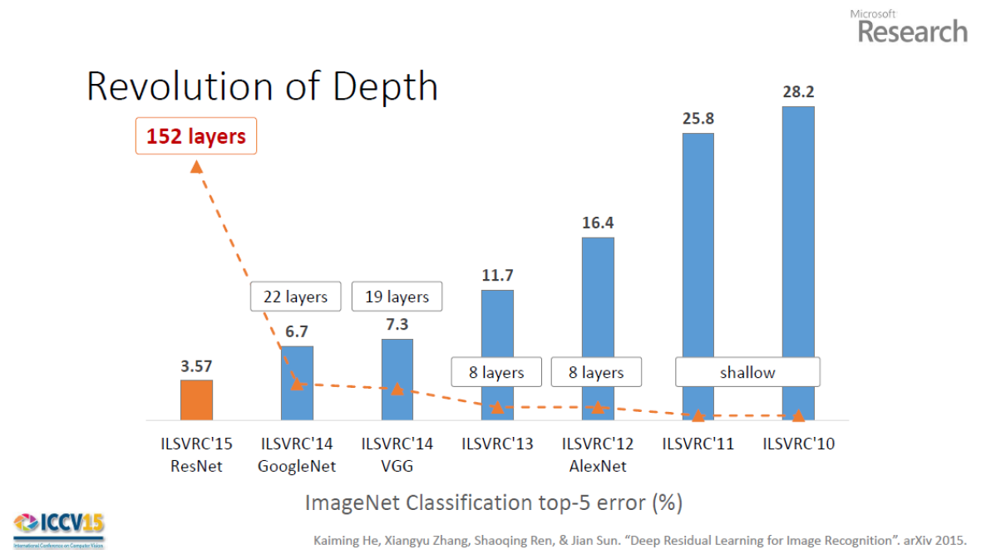
The Network has a pre-defined fixed-size receptive field
Inconsistent labels due to large object size
Convolutional Neural Networks

Slide 3
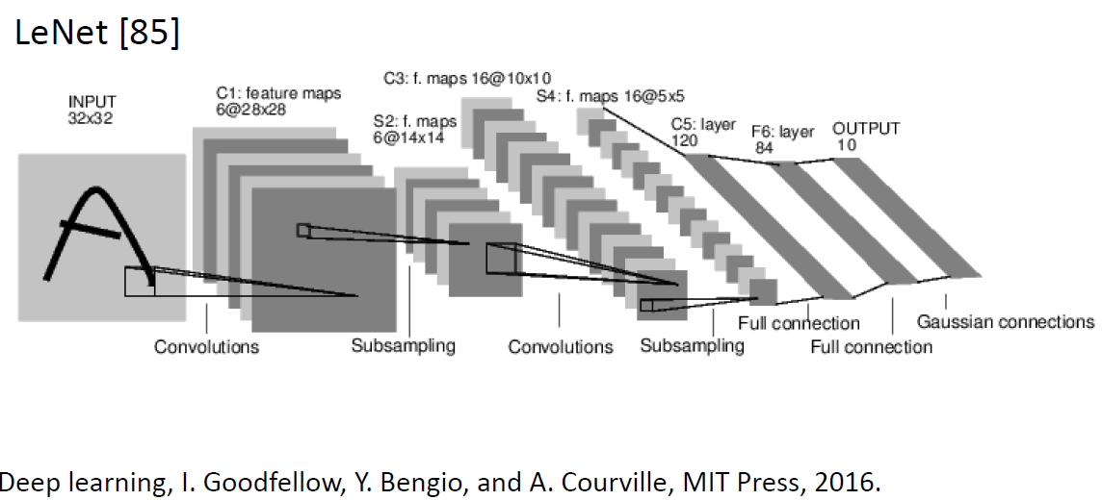
The Network has a pre-defined fixed-size receptive field
Inconsistent labels due to large object size
Convolutional Neural Networks
Convolution layer를 하나라도 포함한 신경망

Slide 4
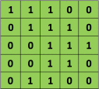
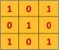


The Network has a pre-defined fixed-size receptive field
Inconsistent labels due to large object size
Convolution operation
Input image
Filter
http://cs231n.github.io/convolutional-networks/

Slide 5

The Network has a pre-defined fixed-size receptive field
Inconsistent labels due to large object size
Convolution operation

Slide 6
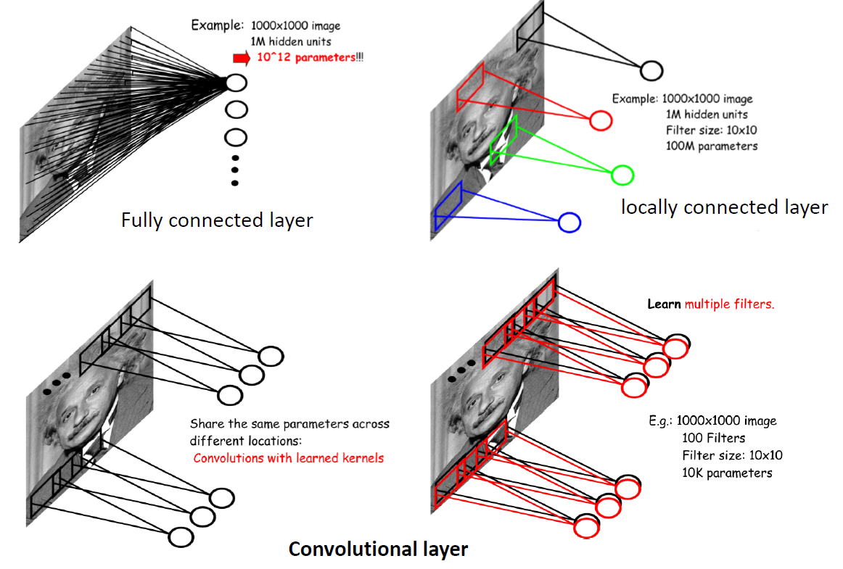
The Network has a pre-defined fixed-size receptive field
Inconsistent labels due to large object size
Convolution Layer 특징

Slide 7
The Network has a pre-defined fixed-size receptive field
Inconsistent labels due to large object size
Convolution Layer 특징
Local Connection
Receptive fields를 이용하여 local connection을 사용
Weight Sharing
한 channel에서의 모든 feature들은 weight을 공유
Parameter가 줄어들어 overfitting에 강해짐

Slide 8
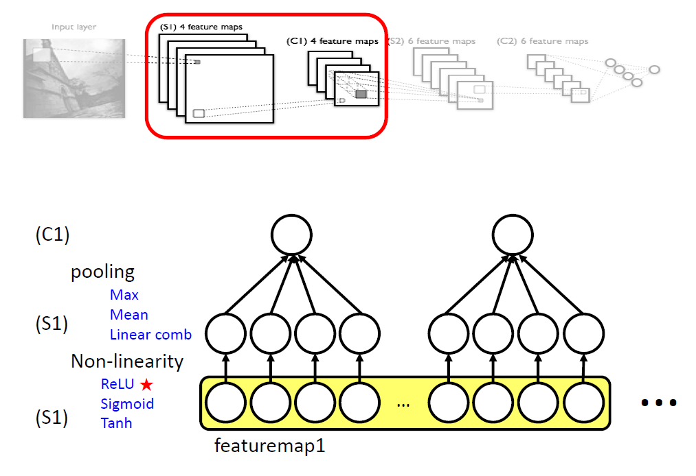
The Network has a pre-defined fixed-size receptive field
Inconsistent labels due to large object size
Pooling Layer

Slide 9
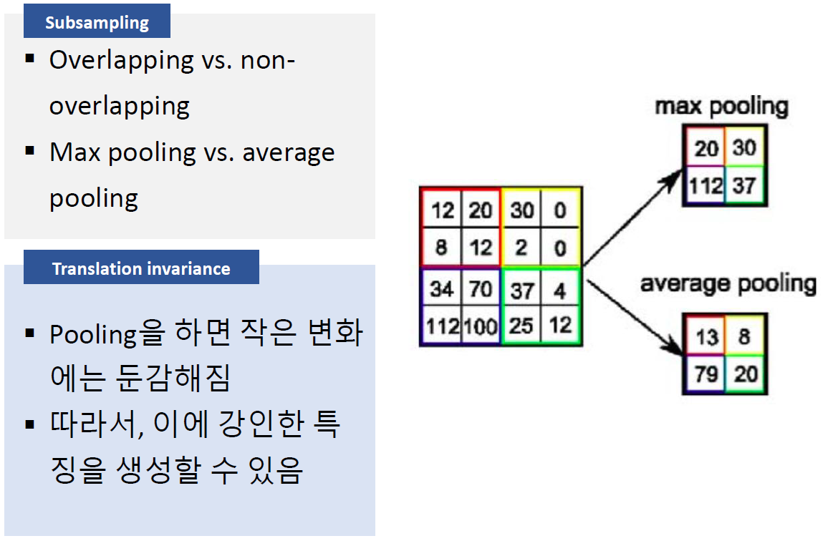
The Network has a pre-defined fixed-size receptive field
Inconsistent labels due to large object size
Pooling Layer

Slide 10
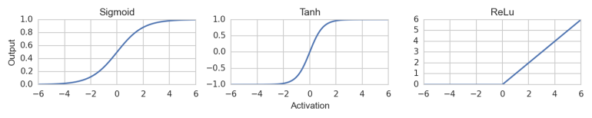

The Network has a pre-defined fixed-size receptive field
Inconsistent labels due to large object size
Non-linearity (ReLU)

Slide 11
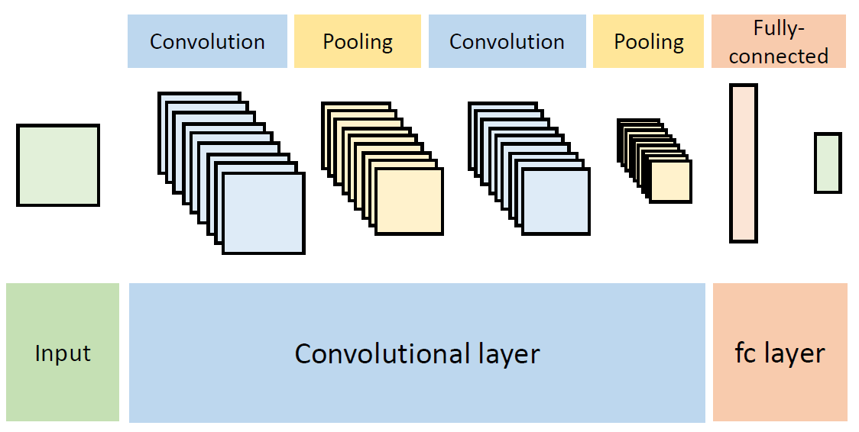
The Network has a pre-defined fixed-size receptive field
Inconsistent labels due to large object size
실습 네트워크 구조
Feature Extractor
Classifier

Slide 12
The Network has a pre-defined fixed-size receptive field
Inconsistent labels due to large object size
실습 네트워크 구조
Conv1
Shape: [5, 5, 1, 32]
Stride: [1, 1, 1, 1]
Pool1
Shape: [1, 2, 2, 1]
Stride: [1, 2, 2, 1]
Image
28 x 28 x 1
Feature map
28 x 28 x 32
Subsampled map
14 x 14 x 32

Slide 13
The Network has a pre-defined fixed-size receptive field
Inconsistent labels due to large object size
실습 네트워크 구조
Conv2
Shape: [5, 5, 32, 64]
Stride: [1, 1, 1, 1]
Pool2
Shape: [1, 2, 2, 1]
Stride: [1, 2, 2, 1]
Subsampled map
14 x 14 x 32
Feature map
14 x 14 x 64
Subsampled map
7 x 7 x 64

Slide 14
The Network has a pre-defined fixed-size receptive field
Inconsistent labels due to large object size
실습 네트워크 구조
FC1
Shape: [7 * 7 * 64, 512]
FC2
Shape: [512, 10]
10
Subsampled map
7 x 7 x 64
512

Slide 15
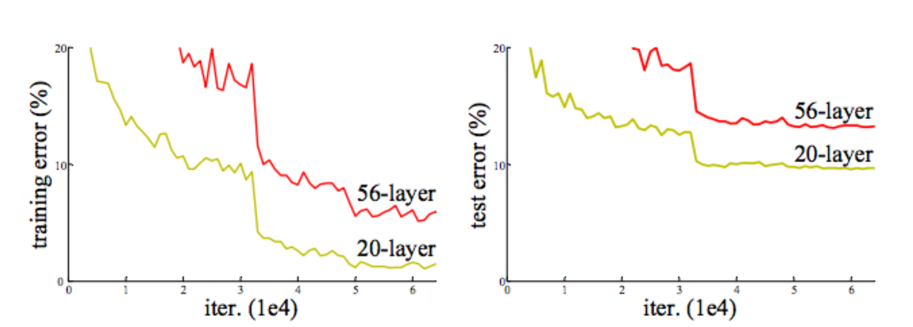
심화: Residual Network
깊은 network는 결과가 좋으나 여러가지 문제를 수반한다
Vanishing/Exploding gradient
Overfitting (많은 parameter)
Training 에러의 증가

Slide 16
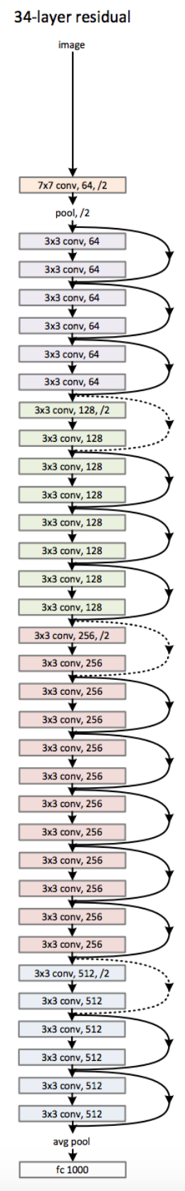
The Network has a pre-defined fixed-size receptive field
Inconsistent labels due to large object size
심화: Residual Network
직접 구현해봅시다
x: 1x1 conv로 차원 늘림
F(x): 첫 번째 layer에서 차원 늘림

